Slide 1
Interactive Data Exploration
Trading Locality for Popularity

Slide 2
Interactive Data Exploration
Interactive Data Exploration is a process that a user can take one of the provided actions to find information that is interesting in a specific (possibly multidimensional) dataset. This work assumes those three navigational primitives:
pan
zoom
jump

Slide 3
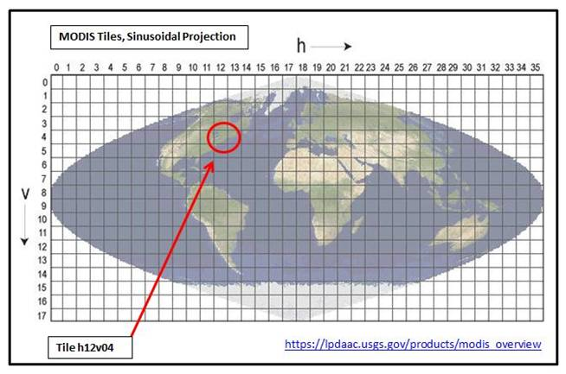
Tiles
Tiles are contiguous ranges of data that can span multiple dimensions
Tiles are rectangular and uniform

Slide 4
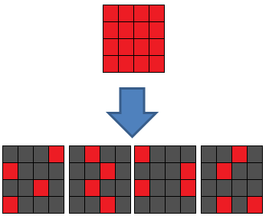
Fragments
Users may be interested to see less than 100% of tile information
When a user zooms in, she requires more data from a tile
Fragments
are non-overlapping partitions of a tile
if all are combined we get a full tile
contain about the same amount of data
lack of data
data

Slide 5
Tiles vs Fragments
Tiles
Fragments
zoom level 1
zoom level 2
zoom level 3
independent
interconnected
popularity decreases
can allow prioritization of data points by popularity
pan , jump
zoom

Slide 6
Problem
Reduction of latency is important, since there is a user in the loop. This can be done through effective prefetching:
Challenges:
numerical measure / ordering of tiles
exploring usefulness of fragments
Prefetching that adapts to accommodate workloads with locality and non-locality

Slide 7


Prefetch Interval
User request 1
User request 2
Fetching
Pre Fetching
Fetching
Pre Fetching
user move latency
user analyzing
results time
$$t_{fetch}$$
$$t_{think}$$
time

Slide 8
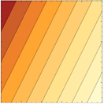
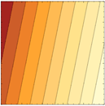
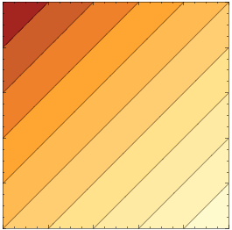
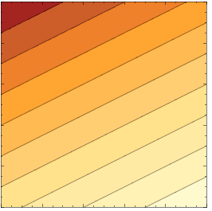
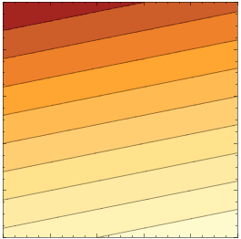





Popularity vs Distance
Only Pans: 1 minus normalized distance is usually enough
Jump & Zoom: new metric is needed: popularity
→ importance is defined as a linear combination of 1-distance and popularity after normalization
1.0
1.0
less important
d
d
1.0
0.0
p
1.0
0.0
0.0
1.0
more important
d
0.0
p
$$i=\frac{1}{3}(2p+(1−d))$$
$$i=\frac{1}{6}(5p+\left(1−d\right))$$
0.0
1.0
1.0
0.0
p
1.0
$$i=1/2(p+(1−d))$$
d
d
0.0
p
1.0
0.0
0.0
p
0.0
1.0
$$i=\frac{1}{3}(p+2(1−d))$$
$$i=\frac{1}{6}(p+5(1−d))$$

Slide 9
Workload Generator
Workloads differ here
0.5
0.1
0.4
pan
jump
zoom
0.75
0.25
deterministic
random
0.25
0.25
0.25
0.25
Randomly zoom in/out according to popularity
up
left
choose neighbor with highest popularity
down
right
sample X tiles and jump to the one with the highest popularity

Slide 10
Workload Generator (Pan)
current
0.5
neighbors
pan
selected
0.75
0.25
1.0
0.4
0.1
0.1
0.3
…
0.3
deterministic
random
0.7
0.2
0.8
0.9
0.8
0.6
0.25
…
…
0.25
0.25
0.1
0.0
0.1
…
0.2
0.25
up
left
choose neighbor with highest popularity
down
right

Slide 11
Workload Generator (Jump)
current
0.1
sampled
jump
selected
1.0
0.4
0.1
0.1
0.3
…
0.3
0.7
0.2
0.8
0.9
0.8
0.6
…
…
0.1
0.0
0.1
…
0.2
sample X tiles and jump to the one with the highest popularity

Slide 12
Workload Generator (zoom)
0.4
zoom level
zoom
1.0
0.4
0.1
0.1
0.3
…
0.3
0.7
0.2
0.8
0.9
0.8
0.5
…
…
80% zoom in
20% zoom out
0.1
0.0
0.1
…
0.2
Randomly zoom in/out according to popularity
10% zoom in
90% zoom out

Slide 13
Experimental Setup
Separate machines for client and server
MySQL is used as back end
Single threaded java client
Database is 10000 fragments (25x25 tiles) ~= 1Gb
1 tile (256x256 pixels) in the viewport
16 fragments/zoom levels per tile
Think time is not constrained

Slide 14
Architecture
Middleware
Server Side Database
Tile Statistics / Predictor
server tiles/
fragments
Config
Middleware
Filtered fetch
request
prefetch
request
Cache Manager
Cache
Current Position
fetch request
rendered tiles
Visualization or other Feedback System
Client side
pan, zoom,
jump

Slide 15
Caching/Prefetching
User Moves
cache
available 0/12
Reorder cache (new distance)
Importance
increases

Slide 16
Caching/Prefetching
User Moves
cache
available 0/12
Reorder cache (new distance)
Importance
increases
New Tile
Fetch

Slide 17
Caching/Prefetching
User Moves
cache
available 4/12
Reorder cache (new distance)
Importance
increases
New Tile
Fetch

Slide 18
Caching/Prefetching
User Moves
cache
available 4/12
Reorder cache (new distance)
Importance
increases
New Tile
Fetch
Candidate Tiles
Prefetch
Importance decreases

Slide 19
Caching/Prefetching
User Moves
cache
available 4/12
Reorder cache (new distance)
0.1
Importance
increases
New Tile
0.3
Fetch
inf
Candidate Tiles
Prefetch
worse than worst in cache
0.6
0.31
0.2
0.09
0.5
Importance decreases

Slide 20
Caching/Prefetching
User Moves
cache
available 2/12
Reorder cache (new distance)
0.1
Importance
increases
New Tile
0.3
Fetch
0.6
Candidate Tiles
inf
Prefetch
worse than worst in cache
0.31
0.2
0.09
0.5
Importance decreases

Slide 21
Caching/Prefetching
User Moves
cache
available 0/12
Reorder cache (new distance)
0.1
Importance
increases
New Tile
0.3
Fetch
0.31
Candidate Tiles
0.6
Prefetch
worse than worst in cache
inf
0.2
0.09
0.5
Importance decreases

Slide 22
Caching/Prefetching
User Moves
cache
available 4/12
Reorder cache (new distance)
Eviction!
Importance
increases
New Tile
0.3
Fetch
0.31
Candidate Tiles
0.6
Prefetch
worse than worst in cache
inf
0.2
0.09
0.5
Importance decreases

Slide 23
Caching/Prefetching
User Moves
cache
available 2/12
Reorder cache (new distance)
0.2
Importance
increases
New Tile
0.3
Fetch
0.31
Candidate Tiles
0.6
Prefetch
worse than worst in cache
inf
0.09
0.5
Importance decreases

Slide 24
Results (1/3)
Mostly Pan: Pan 80%, Zoom 10%, Jump 10%
Pan: Pan 100%, Zoom 0%, Jump 0%
Case 2: Pan 100%, Zoom 0%, Jump 0%

Slide 25
Results (2/3)
Mostly Jump: Pan 10%, Zoom 10%, Jump 80%
Jump Only: Pan 0%, Zoom 0%, Jump 100%
Case 2: Pan 0%, Zoom 0%, Jump 100%

Slide 26
Results (3/3)
Mostly Zoom: Pan 10%, Zoom 80%, Jump 10%
Mixed: Pan 50%, Zoom 40%, Jump 10%

Slide 27
Outcomes
Except for pan and mostly pan workloads, fragments behave better in smaller cache sizes.
For pan and mostly pan workloads,
fragments and tiles are comparable.
Metric should be very local/distance-based for best performance.
Any cache size that can hold 4 tiles is enough.
In jump workloads metric should be popularity-based/non local
In zoom heavy workloads, fragments have a way better performance than tiles
In mixed workload there is improvement of up to 80% using fragments.
jump-only workloads have great performance boost with fragments
Keeping in mind zoom level is always 1 (lowest resolution)
Upper bound for performance gain is 379x using this setup

Slide 28
Future Work
Think time / user interruption
More complicated predictor and real data/workload
Viewports of bigger size (more complicated predictors needed)
Sensitivity analysis

Slide 29
Questions?

Slide 30
Why Fragments aren’t just smaller Tiles?
Fragments are interconnected!
When a user visits a tile, the fragments he needs will be queried all at once. Tiles are independent
Prediction and Eviction is done in Tile basis and not in Fragment basis
Fragments could map to any non-overlapping division of the data and don’t need to be rectangular
Fragments need to be contiguous in the storage medium but not visually while tiles need to be contiguous in both

Slide 31
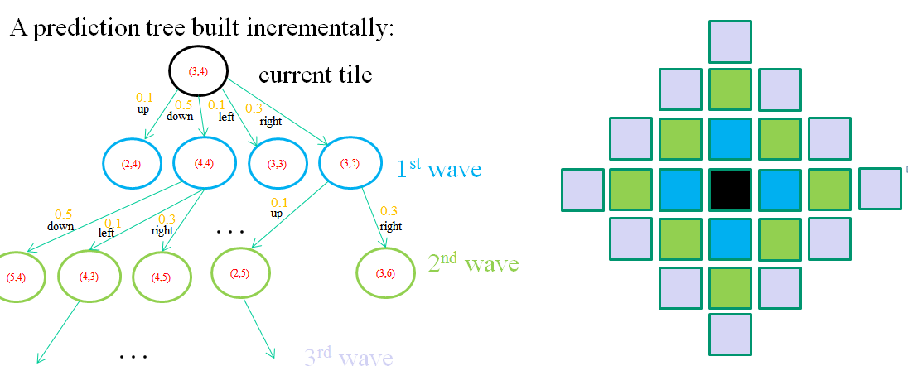
What Happens with Pan only?
Single Step Pans:
Approach 1 Approach 2
Prediction Tree (like Seer) Prediction Tree (with waves)
0.1
0.5
0.1
0.3
up
down
left
right
0.1
0.5
0.1
0.3
0.1
0.3
0.5
0.1
0.3
up
down
left
right
right
0.25
0.05
0.15
0.03
0.09
Based on experiments, we found that when a prediction model is prioritizing tiles that are
in greater distance than 1, the number cache miss ratio goes up.
So Approach 2 is optimal for single step pans

Slide 32
Hidden Slide 1:In favor of Locality…
Approach 1 (Prediction Tree)
Approach 2 (Prediction Tree with Waves)

Slide 33
Popularity? How many fragments? What zoom level
TO CHANGE
Popularity is hard-coded in a map scheme for each of the tiles. This number could be derived from visit/jump counts in a real workload.
The number of fragments for each of the tiles to be prefetched is defined based on importance
The workload assumes that someone is more likely to jump on a tile that is popular. A similar assumption holds for the zoom level. A user is expected to zoom at a lower level (higher detail) when something is more popular.

Slide 34
Prefetching/Caching
TO CHANGE
Algorithm:
Order Cache by Overall Importance in ascending order
Order tiles to be prefetched by Overall Importance in descending order.
Loop through to-be-prefetched tiles and start replacing the worst tile of Cache, till the tile to be added is worse than all of the tiles in Cache or interrupted by a user move
We can have partial/incomplete tiles. There is no ordering among fragments. When a tile is evicted, all of its fragments are evicted.
Animation/Small Example is needed!

